Slide 1



Slide 2

Creativity is part of being an engineer.
We often start with a single solution to a problem and then pursue it as the only possibility.
Need to be creative and generate a variety possible designs.
Need to be able to evaluate different designs.
Systematic generation
BE ABLE TO DEFEND YOUR DESIGN!
Companies want to employ innovative engineers.
Develop your engineering judgment.

Slide 3

By the end of this chapter, you should:
Understand the importance of creativity, innovation, concept generation, and critical evaluation in engineering design.
Be familiar with barriers that hinder creativity.
Be able to apply strategies and formal methods to generate concepts.
Be able to apply techniques for the evaluation of design concepts.

Slide 4

Think of this as a shovel with a coin on the shovel. The problem is to move two of the “toothpicks” so that the coin is no longer in the shovel, but you still have a shovel.
Notes:
| |
|_____|
|
* |
Slide the top of the shovel over by half. People tend to put an artificial constraint and only want to move a toothpick completely. In this case, you only slide it to the right.

Slide 5

Perceptual
Emotional
Cultural and Environmental
Intellectual and Expressive
Notes:
Perceptual blocks
Emotional blocks
Cultural blocks
Intellectual and expressive blocks

Slide 6




Slide 7

“A body is discovered in a park in Chicago in the middle of summer. It has a fractured skull and many other broken bones, but the cause of death was hypothermia.”
Think of the TV show CSI – Crime Scene Investigation. Generate as many solutions as possible to the following scenarios. The idea is to see the problem from a variety of different viewpoints and generate plausible scenarios. You have insufficient information and should examine your assumptions.

Slide 8
Vertical thinking is?
Lateral thinking is?

Slide 9

Have a questioning attitude
Practice being creative
Suspend judgment
All incubation time
Think like a beginner

Slide 10

SCAMPER
Substitute
Combine
Adapt
Modify
Put to other use
Eliminate
Rearrange or Reverse

Slide 11

Search Externally
Literature review
Search and review existing products
Benchmark similar products
Interview experts
Search Internally
Brainstorming/brainwriting
Nominal Group Technique
Concept Table/Fans

Slide 12

Rules for group brainstorming
No evaluation or judgment of ideas permitted.
Encourage wild ideas.
Focus on quantity, not quality (can always toss later!)
Build upon, combine, or modify the ideas of others (SCAMPER).
Record all ideas.

Slide 13

User Interface | Display | Connectivity & Expansion | Power | Size
Keyboard | CRT | Serial & parallel | Battery | Hand-held, Fits in pocket
Touchpad | Flat Panel | USB | AC Power | Notebook size
Handwriting Recognition | Plasma | Wireless Ethernet | Solar Power | Wearable
Video | Heads-up display | Wired Ethernet | Fuel Cell | Credit card size
Voice | LCD | PCMCIA | Thermal transfer | Flexible in shape
 |  | Modem / Telephone

Slide 14

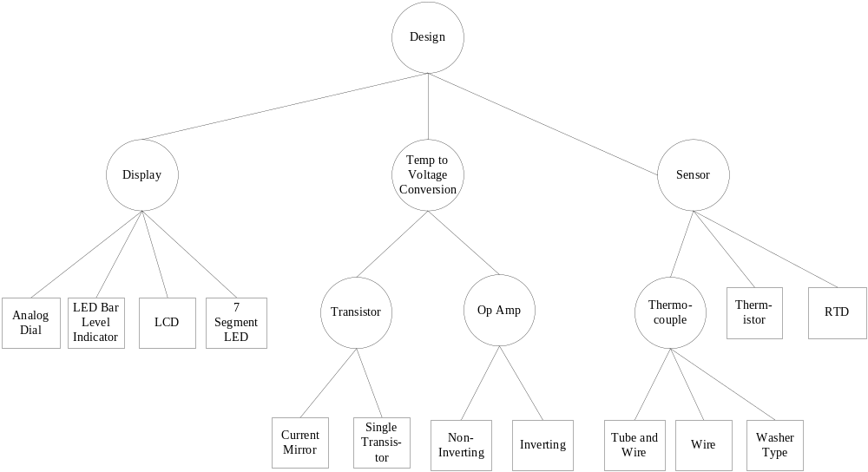

Slide 15

Decision Methods (some of them)
Strength & Weakness Analysis
Analytical Hierarchy Process (Decision Matrix)
Pugh Concept Selection

Slide 16

Identify and list strengths and weaknesses of each concept.
To make more analytical, assign subjective weights to strengths and weaknesses (plus and minus factors) and sum them.

Slide 17

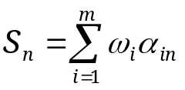
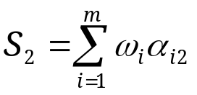
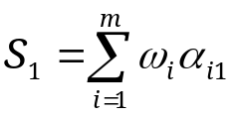
 |  | Design Option 1 | Design Option 2 |  | Design Option n
Criteria 1 |  | α₁₁ | α₁₂ |  | α_{1n}
Criteria 2 |  | α₂₁ | α₂₂ |  | α_{2n}
Criteria m |  | α_{m1} | α_{m2} |  | α_{mn}
Score

Slide 18

Step 1: Determine the selection criteria
Step 2: Select the criteria weightings
Step 3: Identify and rate alternatives relative to the criteria
Step 4: Compute the scores
Step 5: Review the decision
  You can use all the quantitative data you can get, but you still have to distrust it and use your own intelligence and judgment.—Alvin Toffler

Slide 19

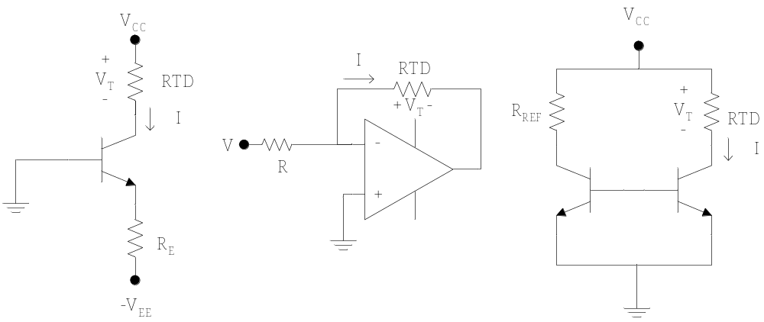
Select a current source circuit for current measurement

Slide 20

In this case they are given as
Accuracy
Cost
Size
Availability

Slide 21

These are computed based upon the results of the pairwise comparison – given in the problem.
Be sure to normalize the final values.

Slide 22

They need to be computed for the following
Accuracy
Cost
Size
Availability

Slide 23
 |  | Single BJT | Op Amp | Current Mirror
Accuracy | 0.42
Cost | 0.12
Size | 0.12
Availability | 0.34
Score

Slide 24

Select the comparison criteria
Determine weights for the criteria
Determine the concepts
Select baseline concept, initially believed best
Compare other concepts to baseline:
  +1 better than, 0 equal to, -1 worse than.
Compute weighted score for concepts, not including the baseline.
Examine concepts: retain, update, or drop. Synthesize best elements of others where possible.
Update table & iterate until best concept emerges.

Slide 25

 |  | Option 1 (Reference) | Option 2 | Option 3 | Option 4
Criteria 1 | 4 | - | 0 | 0 | +1
Criteria 2 | 5 | - | +1 | -1 | 0
Criteria 3 | 2 | - | -1 | 0 | +1
Criteria 4 | 1 | - | +1 | +1 | -1
Score |  | - | 4 | -4 | 5
Continue? |  | Combine | Yes | No | Combine

Slide 26

Identify different design alternatives (see also Chapters 5 and 6).
  Search externally
  Brainstorming sessions.
  Nominal Group Technique
  Morphology (Concept Tables and Fans)
  SCAMPER
Identify leading concept and justify
  Strength & Weaknesses Analysis
  Decision Matrices
  Pugh Concept Selection

Slide 27

Open your mind to creativity
  Innovation is important
  There are strategies to apply
Apply Methods of Concept Generation
  Search externally: Patents, research, experts
  Search internally: SCAMPER, Morph Charts, Concept Fans, Brainstorming, Nominal Group Technique
Evaluate Concepts Critically
  Strengths/Weaknesses
  Decision Matrices
  Pugh Concept Selection

